Slide 1
Sprint Cadence
24 Hrs.
Daily Scrum
Sprint
Product Backlog
Sprint Planning
Sprint Backlog
Sprint Review
Sprint Retro-spective
Releasable Increment
Backlog Refinement

Slide 2
Weekly Sprint
Monday
Tues/Wed/Thu
Friday
Refine product backlog first thing Monday morning.
Refine product backlog first thing each morning.
Refine product backlog first thing each morning.
Plan sprint:
Weekly sprint goal
Pull backlog items for the week
Daily scrum
Daily scrum
Daily scrum
Sprint Review
Sprint Retrospective
This takes about the first hour of the day.
This takes about the first 15-30 mins. Of the day
This takes about the first 15-30 mins of the day and the last hour of the day

Slide 3
Retrospective Board
Worked Well
Needs Improvement
Ideas
Actions

Slide 4
Complexity
Simple
Medium
Complex
Personas
Personal account holders
Commercial and Personal Acct Holders
All account holders
Business Rules
Show current statement transactions
User selects statement to see transactions
User enters custom date range
No sorting of transactions
User can sort by date
User can sort by date, amount, type, pending status
No indication of pending transaction
User is shown pending and not with status indicator
User has option to display pending or not
NFR’s
Connection with user must be encrypted
No minimum performance requirements
List must return within 3 second
List must return in less than .5 seconds

Slide 5
Value/Effort Matrix
User can sort by date, amount, type, pending status
All account holders
User is shown pending and not with status indicator
User has option to display pending or not
User can sort by date or amount
Commercial and Personal Acct Holders
Personal account holders
Value
User selects statement to see transactions
User enters custom date range
Show current statement transactions
No sorting of transactions
No indication of pending transaction
Effort

Slide 8
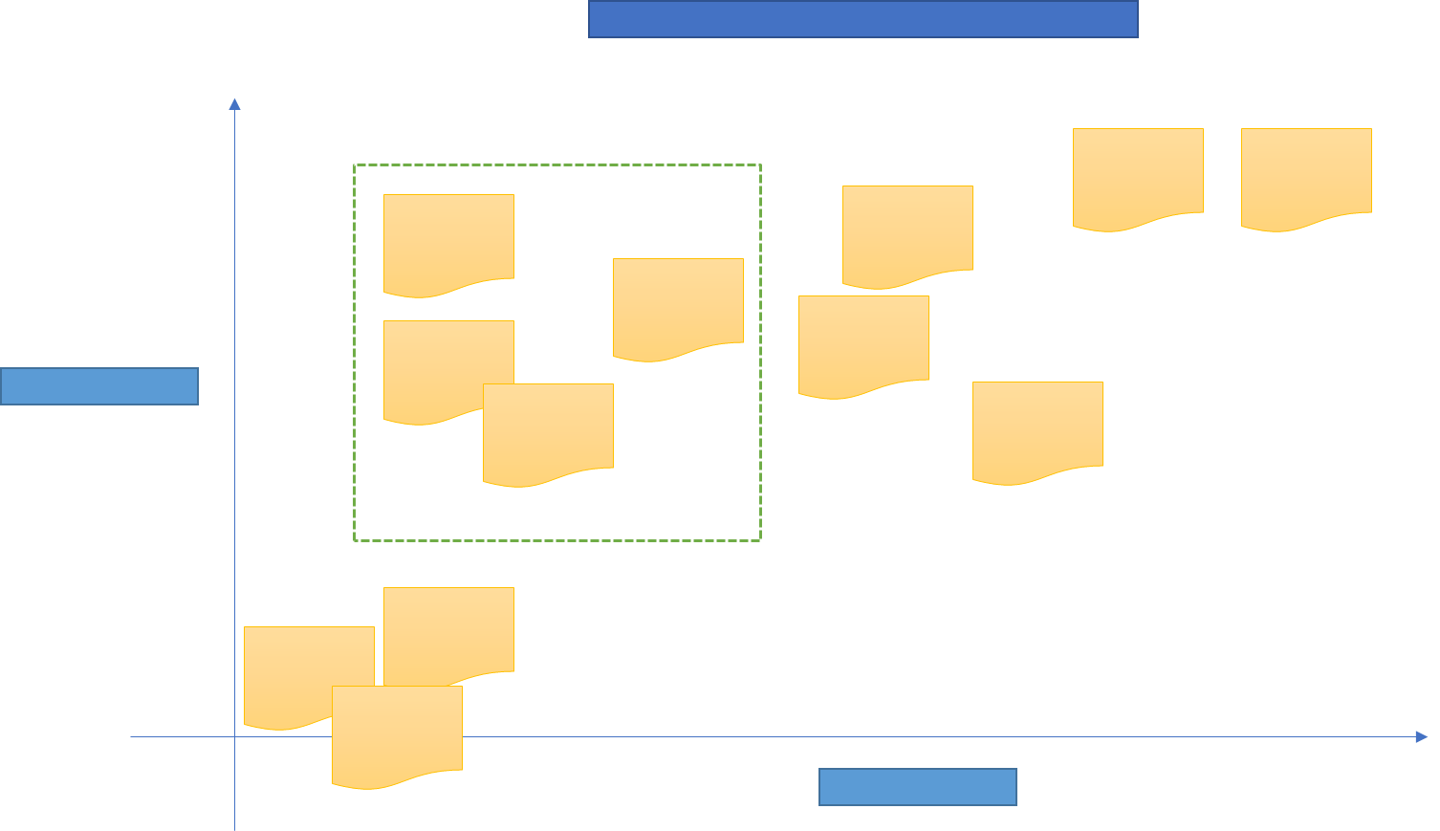

Slide 9


Slide 10
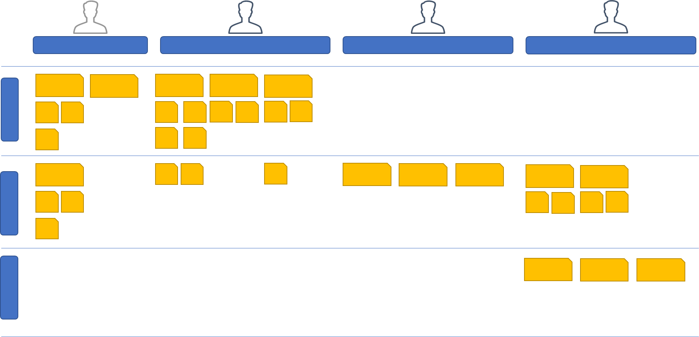

Slide 11
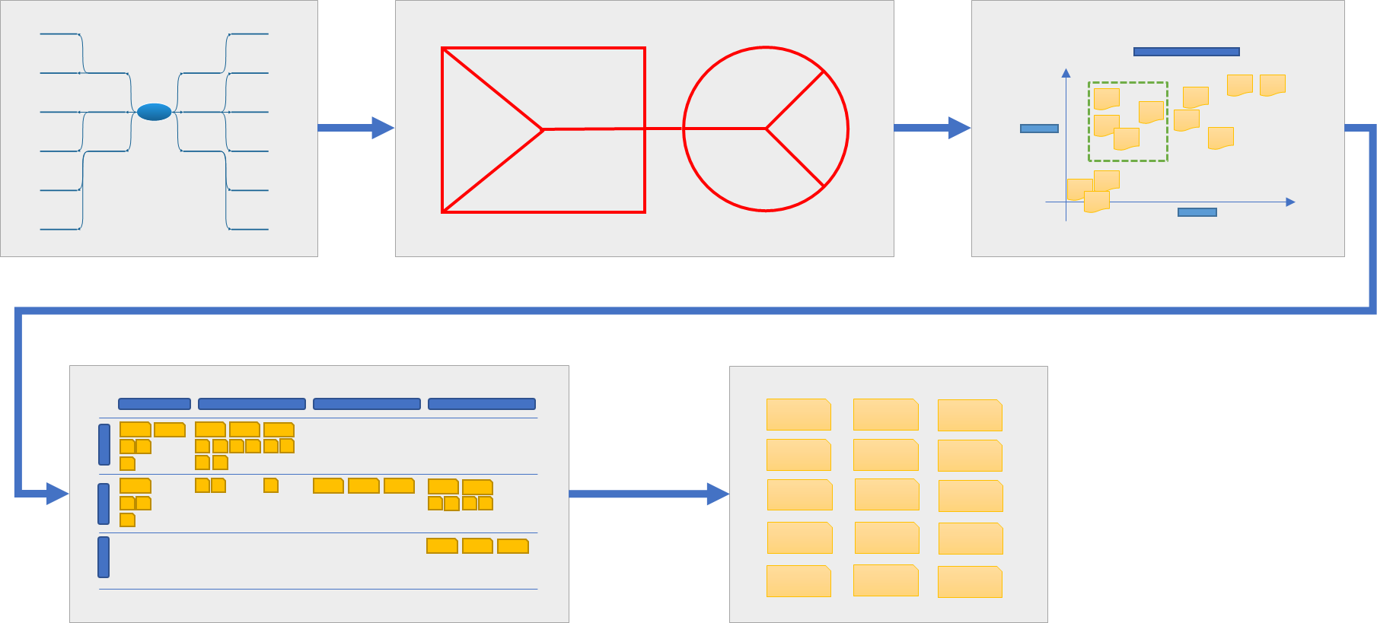

Slide 12
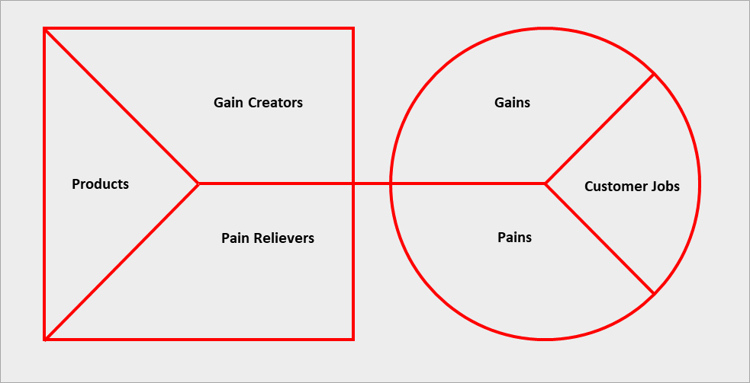
Gain Creators
Gains
Products
Customer Jobs
Pain Relievers
Pains

Slide 13
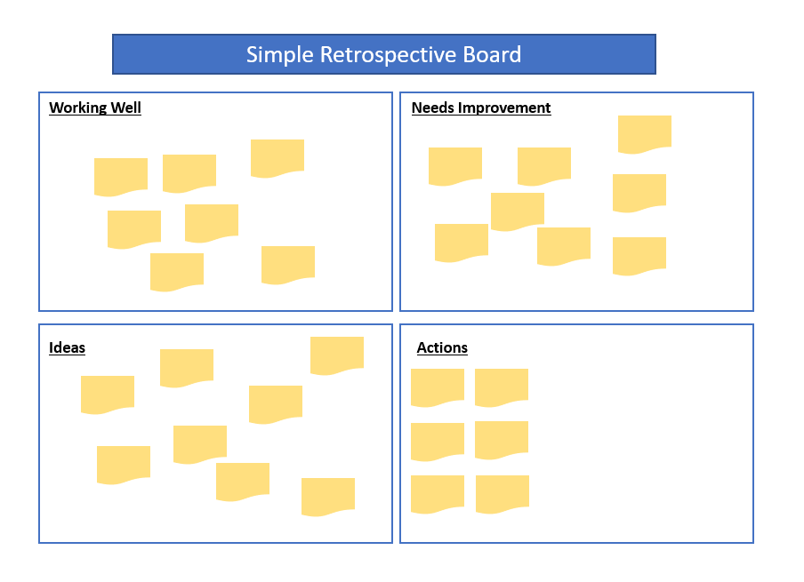
Simple Retrospective Board
Working Well
Needs Improvement
Ideas
Actions

Slide 14
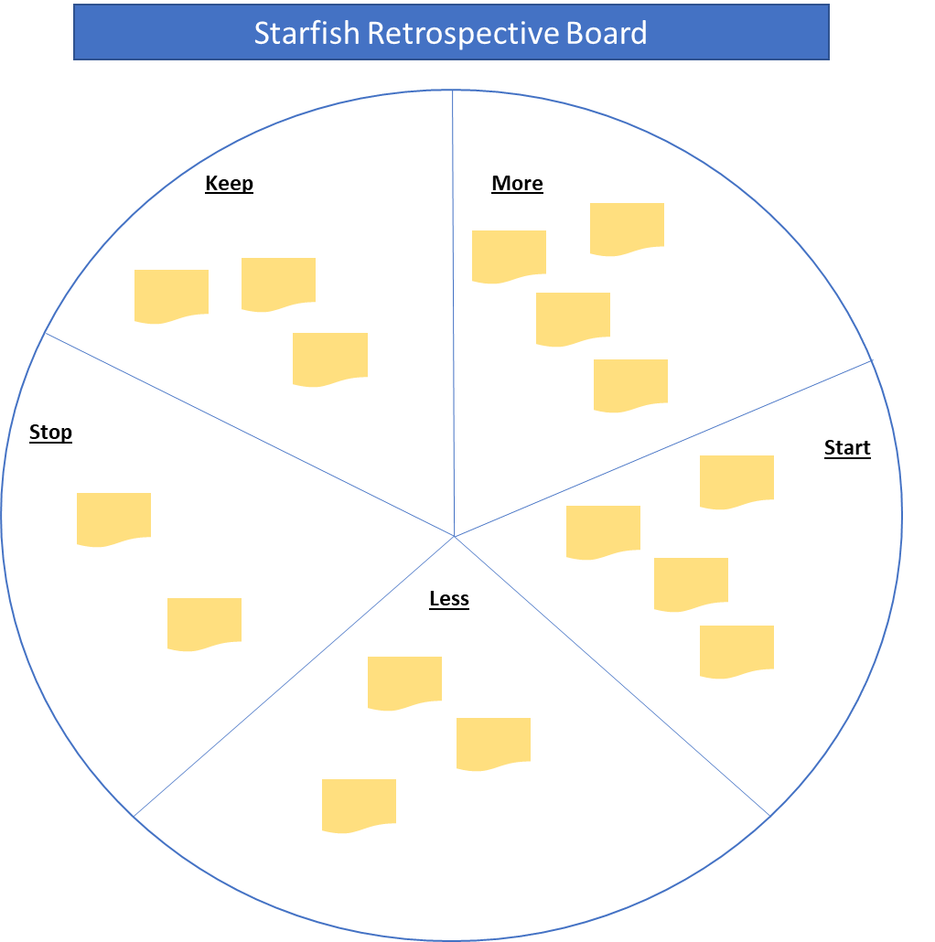
Starfish Retrospective Board
Keep
More
Stop
Start
Less

